Slide 1
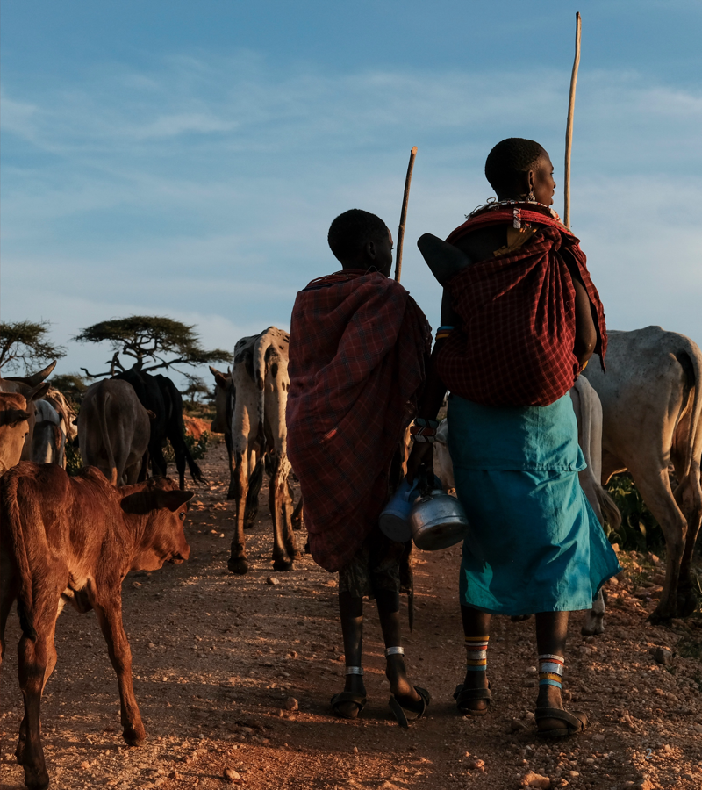

Introduction to bacterial whole-genome sequencing and AMR bioinformatics
KLEBGEN TRAINING · INTRODUCTION
From an isolate to resistance genes, lineages and outbreaks: the core steps of the training pipeline
Neonatal AMR genomic surveillance of K. pneumoniae and E. coli
Africa CDC and ILRI
Introduction to bacterial WGS and AMR bioinformatics
Notes:
An overview talk for the start of the course. It walks through what whole-genome sequencing can tell us about a bacterial isolate, and the core steps of the pipeline we use all course: read QC, assembly, typing, resistance genes, plasmids, phylogeny and reports. Each step is a module later in the course.

Slide 2

What one genome tells us
One sequencing run per isolate answers the questions that used to need many separate lab tests.
Species
Lineage
Resistance
Which organism, including close relatives labs often miss
Sequence type, high-risk clones, capsule and O types
Acquired genes and mutations behind treatment failure
Mobility
Relatedness
Comparable
Which plasmid carries a gene, and whether it can spread
Whether infections are linked: outbreak or coincidence
Same methods in every country: results can be pooled
Introduction to bacterial WGS and AMR bioinformatics
2
Notes:
Each card is one part of the pipeline: species and lineage (typing), resistance (AMR genes), mobility (plasmids), relatedness (phylogeny). The last card is the surveillance argument: when every country runs the same pipeline with the same databases, results can be compared and pooled across the network.

Slide 3
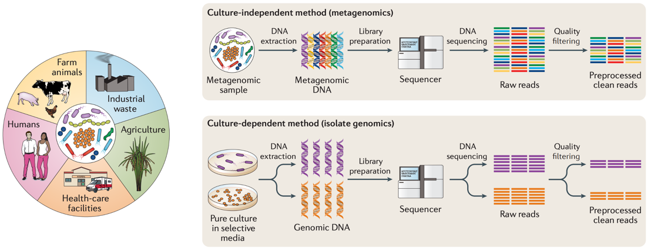
Two ways to sequence for AMR
Boolchandani M, et al. Nat Rev Genet 2019. doi:10.1038/s41576-019-0108-4
This course: isolate genomics. One pure culture per patient isolate → one genome → species, genes, lineage.
Introduction to bacterial WGS and AMR bioinformatics
3
Notes:
Resistance genes circulate between humans, animals, agriculture and the environment, the One Health picture on the left. Metagenomics sequences all the DNA in a sample at once: it shows which resistance genes are present, but not which organism carries them. Isolate genomics starts from a pure culture, so every gene can be tied to one bacterium, its lineage and its plasmids. That is what an outbreak investigation in a neonatal unit needs.

Slide 4

Short reads and long reads
 | Illumina (short reads) | Oxford Nanopore (long reads)
Read length | ~150 bp, paired | Thousands to 100,000+ bp
Base accuracy | Very high | Lower, but improving
Assembly | Many contigs: breaks at repeats | Often complete chromosome and plasmids
Good for | SNPs, gene detection, typing | Plasmids, gene context
Hybrid assembly uses both: long reads for structure, short reads to correct errors.
Introduction to bacterial WGS and AMR bioinformatics
4
Notes:
Most surveillance genomes are Illumina only, and that is enough for species, typing, resistance genes and SNP distances. Long reads matter when the question is where a gene sits: resistance genes are often flanked by insertion sequences, exactly where short-read assemblies break. The pipeline does a hybrid assembly automatically for any isolate that also has Nanopore reads.

Slide 5
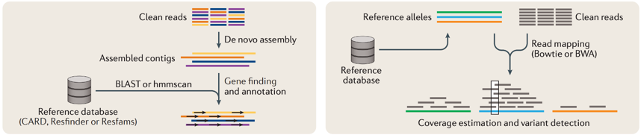
Finding resistance genes: two approaches
Boolchandani M, et al. Nat Rev Genet 2019. doi:10.1038/s41576-019-0108-4
Assembly-based (this pipeline)
Read mapping
Genes found on contigs, with their neighbours and the plasmid they sit on.
Fast and sensitive at low coverage, but loses the genetic context.
Introduction to bacterial WGS and AMR bioinformatics
5
Notes:
Either way, the answer is only as good as the reference database: a curated collection of resistance genes and mutations linked to the drugs they affect. The pipeline uses AMRFinderPlus, NCBI's database and tool, on assemblies; Kleborate adds Klebsiella-specific interpretation. Read mapping is used by tools such as SRST2 and ARIBA, and is common for metagenomes.

Slide 6

From reads to results, step by step
THE TRAINING PIPELINE
neonatal-amr-nf: one Nextflow pipeline for every step of the course
Introduction to bacterial WGS and AMR bioinformatics
6
Notes:
The rest of the talk follows the pipeline used throughout the course. Each step on the next slides is a course module; trainees run each step by hand first, then the whole pipeline in one command.

Slide 7

The pipeline at a glance
INPUT
Illumina reads, ONT reads (optional) or assemblies (contigs), listed in a samplesheet
Step 1
Step 2
Step 3
Step 4
Step 5
Step 6
Step 7
READ QC
ASSEMBLY
TYPING
AMR
PLASMIDS
PHYLOGENY
REPORTS
fastp
Shovill
Kleborate, Kaptive
AMRFinderPlus
MOB-suite
Snippy or SKA2
MultiQC
Kraken2, Bracken
Autocycler, Medaka, polishing
Gubbins, IQ-TREE
Versions, run times
E. coli: ECTyper, EzClermont
Filtlong, NanoPlot
snp-dists
QUAST
Starting from contigs? Steps 1 and 2 are skipped; QUAST still checks the assemblies.
Phylogeny groups come from Kleborate: one tree per species and ST.
Introduction to bacterial WGS and AMR bioinformatics
7
Notes:
This is the workflow figure from the pipeline README, laid out left to right. Each box is one step on the following slides. Optional extras not shown: Prokka or Bakta annotation, and running both Snippy and SKA2 to compare their SNP distances.

Slide 8
Step 1 · Read quality control
Tool | What it does
fastp | Trims adapters and low-quality bases; reports quality and length
Kraken2, Bracken | Which species the reads come from: contamination check
Filtlong | Keeps the longest, best long reads
NanoPlot | Long-read length and quality plots
QUESTION
Are the reads good enough, and from one organism?
RESULTS
01_qc/
Watch for: low coverage, a second species (mixed culture), or a species that does not match the lab.
Introduction to bacterial WGS and AMR bioinformatics · Module 1
8
Notes:
Everything downstream depends on this step: a contaminated or low-coverage sample gives a fragmented assembly, false gene calls and wrong SNP distances. Kraken2 classifies each read against a reference database; Bracken turns those counts into species abundances. Day 1 covers this in detail.

Slide 9
Step 2 · Genome assembly
Tool | What it does
Shovill | Short-read assembly into contigs
Autocycler, Medaka | Long-read consensus assembly, then error correction
Polypolish, Pypolca | Polish the long-read assembly with short reads: the hybrid
QUAST | Size, number of contigs, N50
QUESTION
Rebuild the genome from millions of short pieces
RESULTS
02_assembly/
One best assembly per isolate goes forward: the hybrid if there is one, otherwise the short-read assembly.
Introduction to bacterial WGS and AMR bioinformatics · Module 2
9
Notes:
A K. pneumoniae genome is around 5.5 Mb. A good short-read assembly has tens to a few hundred contigs; a good hybrid has one circular chromosome plus one contig per plasmid. A total length far from the expected size, or thousands of tiny contigs, points back to a QC problem. Day 2 covers both routes.

Slide 10
Step 3 · Species and typing
Tool | What it does
Kleborate | Species within the K. pneumoniae complex, MLST, K and O loci, resistance and virulence scores
Kaptive | Capsule (K) and O-antigen loci in detail
ECTyper | E. coli serotype
EzClermont | E. coli phylogroup
QUESTION
Which species and lineage is it?
RESULTS
03_typing/
The sequence type (ST) places each isolate in a lineage, and flags known high-risk clones.
Introduction to bacterial WGS and AMR bioinformatics · Modules 3, 7
10
Notes:
Lab methods often report K. variicola and K. quasipneumoniae as K. pneumoniae; the genome tells them apart. MLST uses seven housekeeping genes: good for naming lineages, too coarse for outbreaks, which is why we also build trees. Capsule and O types matter for future vaccines (Day 8). Kleborate's species and ST also decide the phylogeny groups.

Slide 11
Step 4 · Resistance and virulence genes
QUESTION
AMRFinderPlus
Which antibiotics will still work?
NCBI's curated genes and point mutations, with the drug class each affects; with --plus, virulence and stress genes too.
RESULTS
04_amr/
Key genes in neonatal sepsis
blaCTX-M (ESBL), blaNDM / OXA-48 (carbapenemases), aac(3) (gentamicin)
A gene is a prediction: compare with lab AST, and separate intrinsic genes (SHV in K. pneumoniae) from acquired ones.
Introduction to bacterial WGS and AMR bioinformatics · Module 4
11
Notes:
The WHO first-line regimen for neonatal sepsis is ampicillin plus gentamicin. K. pneumoniae is intrinsically resistant to ampicillin (chromosomal SHV), so the regimen relies on gentamicin, and an acquired aac(3) gene removes it. Genotype and phenotype agree well overall, but not perfectly: Day 4 measures the agreement against the lab's results.

Slide 12
Step 5 · Plasmids
QUESTION
MOB-suite
Where do the resistance genes live, and can they spread?
Sorts contigs into chromosome and plasmids; reports each plasmid's size, replicon (Inc) type, mobility and cluster.
RESULTS
05_plasmids/
Why it matters
The same plasmid in different lineages means resistance is spreading between bacteria, not one clone.
Short reads rarely give complete plasmids; hybrid assemblies usually do.
Introduction to bacterial WGS and AMR bioinformatics · Module 5
12
Notes:
Many of the resistance genes that matter most, ESBLs and carbapenemases, travel on plasmids. A plasmid can move between lineages and even species, so a plasmid outbreak can be invisible to typing by ST. Days 4 and 5 reconstruct plasmids, compare hybrid with short-read results, and look for plasmids shared between lineages.

Slide 13

Step 6 · Phylogeny and SNP distances
GROUP
SNPs
RECOMBINATION
TREE
DISTANCES
Isolates of one species and ST
Snippy (map to a reference) or SKA2 (split k-mers)
Gubbins removes imported DNA
IQ-TREE maximum-likelihood tree
snp-dists: SNPs between every pair
Question
A few SNPs apart
Are these infections linked? Results in 06_phylogeny/.
Evidence of recent transmission, not proof: read it with ward and dates.
Introduction to bacterial WGS and AMR bioinformatics · Module 6
13
Notes:
Trees are built within one ST: between distant lineages, recombination dominates and SNP counts say nothing about transmission. Recombination imports many SNPs in one event, which would make linked isolates look unrelated, so Gubbins removes it first. The pipeline can run both Snippy and SKA2 and compare them: a conclusion should hold with either. Days 6 and 7 cover this, ending with an outbreak summary for an infection prevention team.

Slide 14
Step 7 · Reports and outputs
Folder | Contents | Step
01_qc/ | fastp, Kraken2, Bracken, long-read QC | 1
02_assembly/ | Assemblies and QUAST | 2
03_typing/ | Kleborate, Kaptive, E. coli typing | 3
04_amr/ | AMRFinderPlus | 4
05_plasmids/ | MOB-suite | 5
06_phylogeny/ | Trees and SNP-distance matrices per ST | 6
multiqc/ | One summary report for all isolates | 7
pipeline_info/ | Software versions, run time per step | 7
Introduction to bacterial WGS and AMR bioinformatics · Module 8
14
Notes:
Every folder matches a step, and a day of the course. MultiQC is the first thing to open after a run: QC and assembly statistics for every isolate side by side. pipeline_info records exactly which software versions produced the results, which belongs in any report. R scripts then turn these folders into figures and transmission tables (Days 8 and 9).

Slide 15

Beyond single genomes
FROM GENOMES TO ACTION
Comparing many isolates, and running the analysis in one command
Introduction to bacterial WGS and AMR bioinformatics
15
Notes:
Surveillance is about patterns across many isolates: which genes, lineages and plasmids are common, and whether they cluster in place and time.

Slide 16
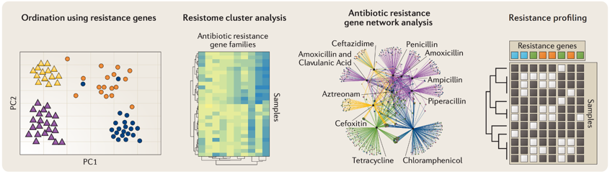
Looking across many isolates
Boolchandani M, et al. Nat Rev Genet 2019. doi:10.1038/s41576-019-0108-4
In the course: gene × isolate profiles beside the tree, coloured by ward and year, and summaries per country.
Introduction to bacterial WGS and AMR bioinformatics · Modules 6–8
16
Notes:
Once every isolate has a gene list, the collection can be compared: which isolates share a resistance profile, which genes travel together, how profiles group by source. The resistance profile on the right, a gene-by-isolate matrix next to a tree, is the figure we build on Days 8 and 9, with ward and year alongside.

Slide 17
Every step, in one command
nextflow run neonatal-amr-nf/main.nf -profile singularity -c site.config \
--input samplesheet.csv --outdir results \
--kraken2_db k2db --amrfinderplus_db amrfinderdb.tar.gz
Reproducible
Scalable
Every tool runs in a container at a fixed version; versions are recorded.
Each step is its own job on the HPC; many isolates run in parallel.
Resumable
Reads or assemblies
-resume reuses finished steps after a stop or a change.
Starts from FASTQ files or from contigs made elsewhere.
Introduction to bacterial WGS and AMR bioinformatics
17
Notes:
The pipeline is built with Nextflow and follows nf-core conventions: community modules where they exist, local modules for the rest. The paths in the command are placeholders; on the course server the shared images and databases are set by the site configuration. On Day 5 each country runs it on its own assemblies.

Slide 18
Key messages
1
Quality first. Contaminated or low-coverage data give wrong answers at every later step.
2
Genes are predictions. Read them against lab AST and against intrinsic resistance.
3
Context matters. The same gene on a plasmid can move between lineages.
4
Genomics plus epidemiology. SNP distances flag links; ward and dates decide them.
Introduction to bacterial WGS and AMR bioinformatics
18
Notes:
Four ideas that run through the whole course. If participants remember only these, the details of each tool can be looked up later.

Slide 19
Questions?
Next: Day 1 · The command line, software environments and read quality control
Introduction to bacterial WGS and AMR bioinformatics
19
Notes:
Hand over to the Day 1 sessions, which start with the computing environment and then the first pipeline step, read quality control.

